Slide 1

Cardiovascular Disease Prediction
Final Model Evaluation & Results
Machine-learning classification project
Final selected model: Decision Tree
Final accuracy: 72.78%

Slide 2
1. Dataset loading and data analysis
2. Data preprocessing and blood-pressure cleaning
3. Exploratory data visualization
4. Model training and comparison
5. Decision Tree hyperparameter tuning
6. Final model evaluation and confusion matrix
Project Workflow

Slide 3
Dataset & Preprocessing
Original dataset: 70,000 rows
Duplicate rows: 0
Rows after cleaning: 68,672
Rows removed during blood-pressure cleaning: 1,328
Age converted to years: 30–65 years
Cleaned dataset saved as Output/cardio_cleaned.csv

Slide 4
Visualization Findings
Disease distribution was examined using class counts.
Age, gender, cholesterol, glucose, physical activity, smoking and alcohol were compared with disease status.
Boxplots showed higher central blood-pressure values for the disease group.
Correlation heatmap: weight–BMI ≈ 0.76 and systolic–diastolic BP ≈ 0.73.
Target correlations included systolic BP ≈ 0.43 and BMI ≈ 0.16.

Slide 5
Model Comparison
Model | Accuracy
Logistic Regression | 72.28%
Decision Tree | 72.70%
Random Forest | 70.64%

Slide 6
Decision Tree Tuning
Max Depth 3 → 72.25%
Max Depth 5 → 72.78% ★ BEST
Max Depth 7 → 72.67%
Max Depth 10 → 72.29%
Max Depth 15 → 70.23%
Max Depth 20 → 67.27%

Slide 7
Algorithm: Decision Tree Classifier
Maximum depth: 5
Random state: 42
Final test accuracy: 72.78%
Saved model: Output/final_decision_tree_model.pkl
Final Model

Slide 8
Final Confusion Matrix
Actual / Predicted | No Disease | Disease
No Disease | 5746 | 1194
Disease | 2545 | 4250

Slide 9
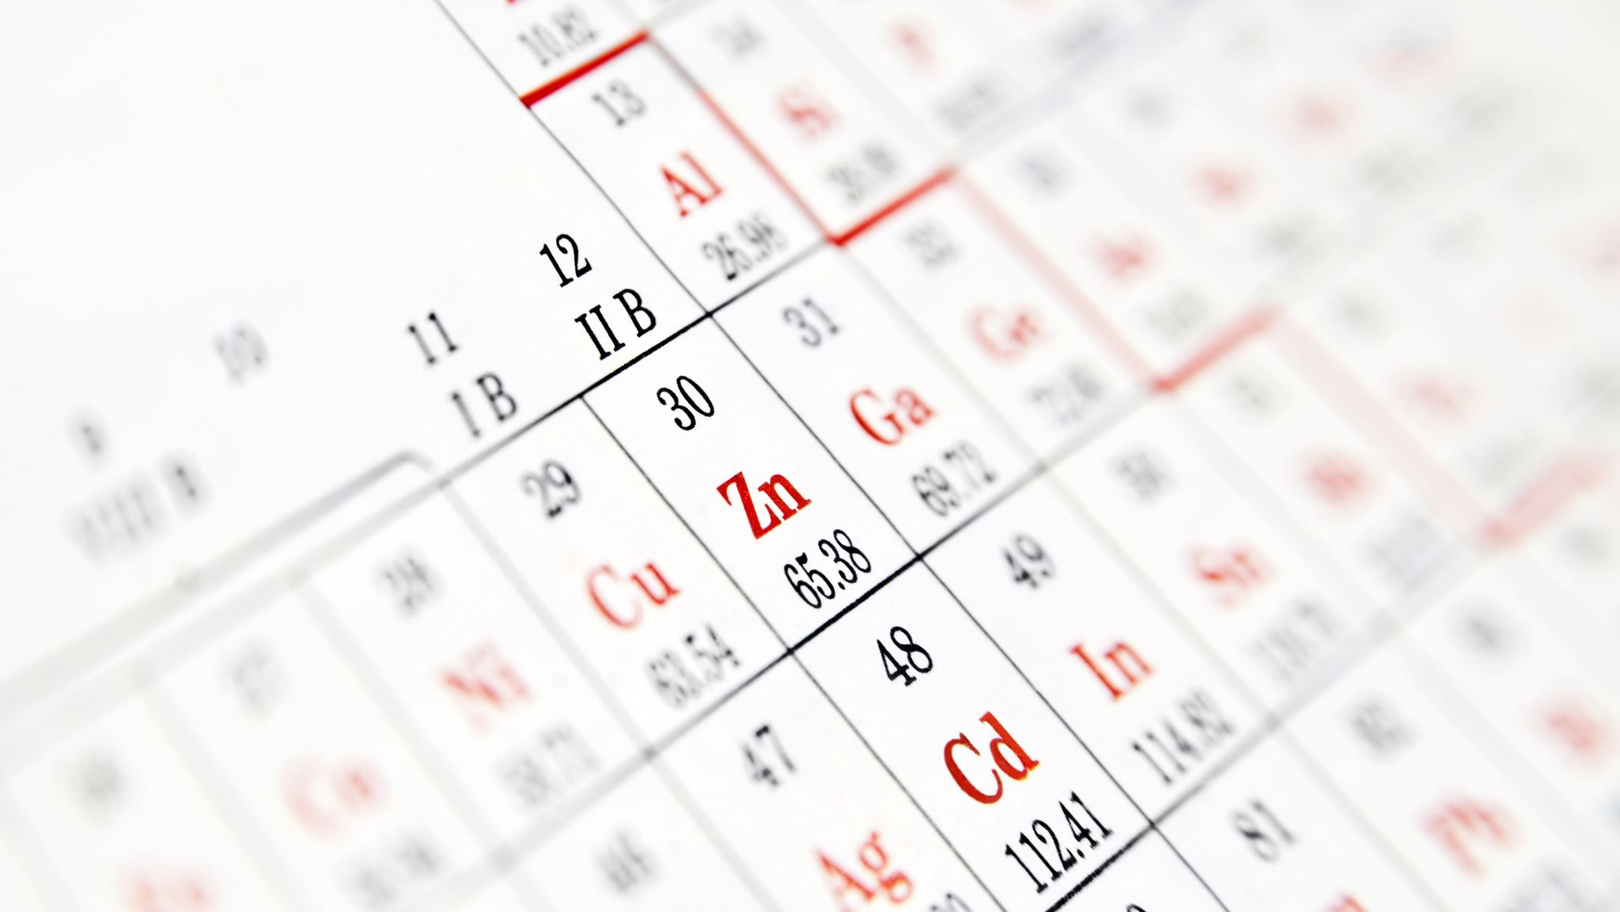
Final Classification Metrics
No Disease (0): Precision 0.69, Recall 0.83, F1-score 0.75
Disease (1): Precision 0.78, Recall 0.63, F1-score 0.69
The metrics are calculated from the final confusion matrix.
The model correctly classified 9,996 of 13,735 test records.

Slide 10
Conclusion
The complete machine-learning pipeline was successfully completed.
Decision Tree with max_depth = 5 gave the highest observed accuracy: 72.78%.
The final model and confusion-matrix image were saved in the Output folder.
The project is suitable for academic demonstration.
It should not be used as a medical diagnosis without independent clinical validation.

